Slide 1
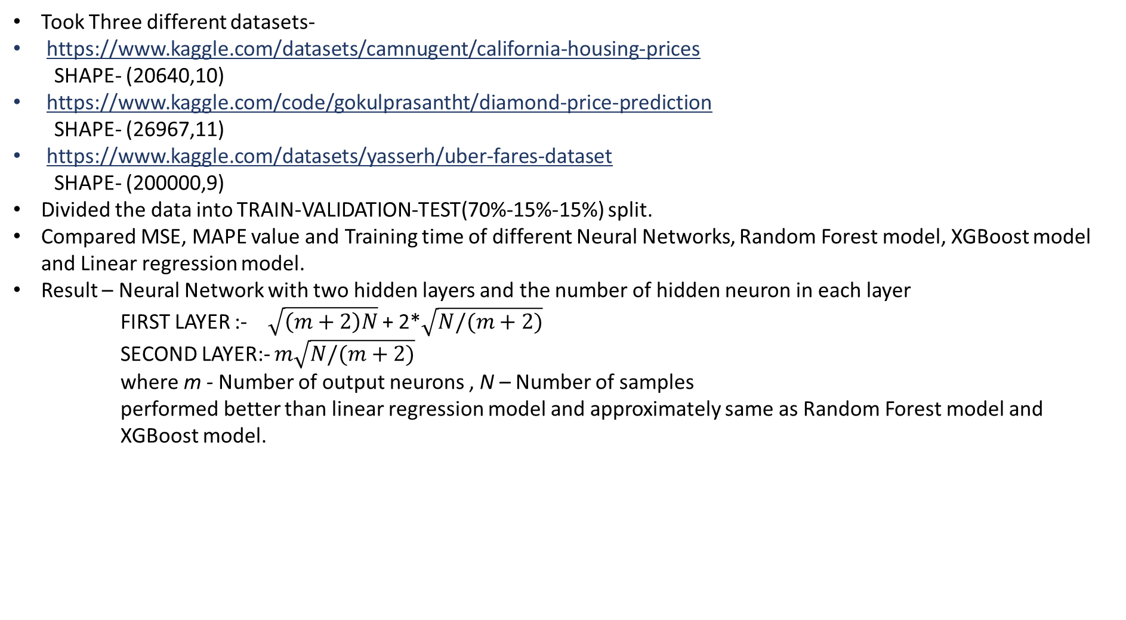
APPLICATION OF KERNEL METHODS TO IMPROVE COMPUTATIONAL PERFORMANCE OF FEED FORWARD NEURAL NETWORKS.
Took Three different datasets-
https://www.kaggle.com/datasets/camnugent/california-housing-prices
SHAPE- (20640,10)
https://www.kaggle.com/code/gokulprasantht/diamond-price-prediction
SHAPE- (26967,11)
https://www.kaggle.com/datasets/yasserh/uber-fares-dataset
SHAPE- (200000,9)
Divided the data into TRAIN-VALIDATION-TEST(70%-15%-15%) split.
Compared MSE, MAPE value and Training time of different Neural Networks, Random Forest model, XGBoost model and Linear regression model.
Result – Neural Network with two hidden layers and the number of hidden neuron in each layer
FIRST LAYER :-$\sqrt{\left(m+2\right)N}$ + 2*$\sqrt{N/(m+2)}$
SECOND LAYER:- $m\sqrt{N/(m+2)}$
where m - Number of output neurons , N – Number of samples
performed better than linear regression model and approximately same as Random Forest model and
XGBoost model.

Slide 2
Learning Capability and Storage Capacity of
Two-Hidden-Layer Feedforward Networks
Guang-Bin Huang, Member, IEEE
IEEE TRANSACTIONS ON NEURAL NETWORKS, VOL. 14, NO. 2, MARCH 2003
URL Link - https://ieeexplore.ieee.org/document/1189626
This paper rigorously proved in a constructive way that TLFNs with $\sqrt{\left(m+2\right)N}$ + 2*$\sqrt{N/(m+2)}$neurons and $m\sqrt{N/(m+2)}$neurons in the first and second hidden layers, respectively, can learn N distinct samples.

Slide 3
RESULTS :-
 | MSE(TEST) | MAPE | TRAINING TIME(SEC)
MODEL –NEURAL NETWORK | 0.145 | 0.911 | 972.61
RANDOM FOREST | 0.144 | 0.942 | 110.37
XGBOOST | 0.143 | 0.924 | 25.95
LINEAR REGRESSION | 0.169 | 1.074 | 0.052
uber-fares-dataset
MODEL –NEURAL NETWORK | 0.022 | 0.366 | 151.32
RANDOM FOREST | 0.023 | 0.376 | 24.88
XGBOOST | 0.022 | 0.344 | 09.33
LINEAR REGRESSION | 0.119 | 0.886 | 0.019
diamond-price-prediction
MODEL –NEURAL NETWORK | 0.205 | 1.25 | 104.61
RANDOM FOREST | 0.194 | 1.24 | 27.90
XGBOOST | 0.182 | 1.27 | 13.04
LINEAR REGRESSION | 0.341 | 1.62 | 0.05
california-housing-prices

Slide 4
CONCLUSION :
Observed that Neural Network performed better than linear regression model and approximately same as Random Forest model and XGBoost model (using the MAPE value) but it consumes more time for training the datasets compare to other models.
So, Random forest performance is almost same as our Neural Network and it takes less time.
TASK:
Now, we need to show that their also exists datasets where Neural Network performed better than Random Forest.
Created synthetic datasets where target variable y is a non linear function of input variables(with no human influence) .
Here while comparing we saw that Neural Network is performing better than Random forests and other models.

Slide 5
DATASET _1 dimension-(26967,7)
y = x1*x2*x3-(x4 * 0.1)+tan(x5)*x6+x7
 | MSE(TEST) | MAPE | R2 Score | TRAINING TIME(SEC)
MODEL –NEURAL NETWORK | 0.0003 | 0.067 | 0.999 | 108.3
RANDOM FOREST | 0.0009 | 0.192 | 0.999 | 11.16
XGBOOST | 0.0021 | 0.397 | 0.997 | 0.046
LINEAR REGRESSION | 0.0004 | 0.106 | 0.999 | 0.017
DATASET_2- dimension-(100000,10)
y =(x1/(x2*x3))-5*x4+tan(x5)+x7+sin(x6)+(x8/x9)+(x0)
 | MSE(TEST) | MAPE | R2 score | TRAINING TIME(SEC)
MODEL –NEURAL NETWORK | 0.270 | 3.450 | 0.738 | 650.4
RANDOM FOREST | 0.746 | 5.150 | 0.276 | 213.7
XGBOOST | 0.792 | 5.981 | 0.233 | 1.579
LINEAR REGRESSION | 0.897 | 5.803 | 0.131 | 0.056

